Slide 1
Measuring Biodiversity
Key Concepts:
Species richness
Species evenness
Simpson’s Index of Diversity (D)

Slide 2
Species richness
This is a qualitative description…
Eg “how many different species can I see?”
More species does not always mean more biodiversity…why not?
…because there may not be many individuals of each species (evenness)

Slide 3
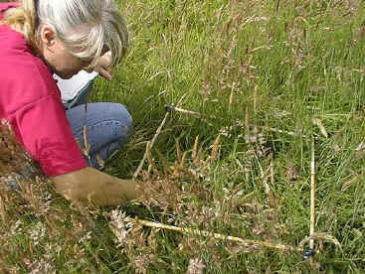
Species evenness
This is a quantitative measurement
It is a measure of the abundance of individuals in each species.

Slide 4
Abundance can be measured…
Percentage cover – the proportion of each quadrat occupied by the species.
Population density – the number of individuals per quadrat
Species frequency – the proportion of quadrats with the species in it.

Slide 5
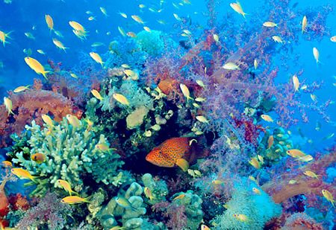
When both species richness and species evenness increase, there is by definition an increase in BIODIVERSITY.

Slide 6
Which field shows the most biodiversity?
Species observed | Percentage cover
 | Field A | Field B
Cocksfoot grass | 57 | 38
Timothy grass | 32 | 16
Buttercup | 3 | 14
Clover | 3 | 22
Thistle | 1 | 5
Dandelion | 4 | 5
Total | 100 | 100
Both have the same ‘richness’ ( 6 species), but Field B has greater ‘evenness’; so Field B is more diverse.

Slide 7
Simpson’s diversity index (D) is a measure of biodiversity that takes into account richness and evenness.
A high value for D is ‘good’ and means the habitat is diverse, species rich, and able to withstand some environmental impact.
A low value for D is ‘poor’ and means the habitat is low in species, so a small change to the environment ( eg pollution) would have a serious impact.

Slide 8
Looks complex but it’s not..!
D = 1 – [ ∑ ( n / N)² ]
n = number of individuals
N = total number of individuals

Slide 9
Calculating Simpsons diversity index (D)
Species observed | Percentage cover
 | Field A (n) | Field B (n)
Cocksfoot grass | 57 | 38
Timothy grass | 32 | 16
Buttercup | 3 | 14
Clover | 3 | 22
Thistle | 1 | 5
Dandelion | 4 | 5
Total (N) | 100 | 100
D = 1 – [ ∑ ( n / N)² ]

Slide 10
Calculating Simpsons diversity index (D)
Species observed | Percentage cover
 | Field A (n) | n/N
Cocksfoot grass | 57 | 0.57
Timothy grass | 32 | 0.32
Buttercup | 3 | 0.03
Clover | 3 | 0.03
Thistle | 1 | 0.01
Dandelion | 4 | 0.04
Total (N) | 100
D = 1 – [ ∑ ( n / N)² ]

Slide 11
Calculating Simpsons diversity index (D)
Species observed | Percentage cover
 | Field A (n) | n/N | (n/N)²
Cocksfoot grass | 57 | 0.57 | 0.349
Timothy grass | 32 | 0.32 | 0.1024
Buttercup | 3 | 0.03 | 0.0009
Clover | 3 | 0.03 | 0.0009
Thistle | 1 | 0.01 | 0.0001
Dandelion | 4 | 0.04 | 0.0016
Total (N) | 100 |  | ∑ = 0.4308
D = 1 – [ ∑ ( n / N)² ]
D = 1 – 0.4308
D = 0.5692

Slide 12
Now calculate (D) for Field B…
Species observed | Percentage cover
 | Field A (n) | Field B (n)
Cocksfoot grass | 57 | 38
Timothy grass | 32 | 16
Buttercup | 3 | 14
Clover | 3 | 22
Thistle | 1 | 5
Dandelion | 4 | 5
Total (N) | 100 | 100
D = 1 – [ ∑ ( n / N)² ]

Slide 13
Field B (D)
Species observed | Percentage cover
 | Field B (n) | n/N | (n/N)²
Cocksfoot grass | 38 | 0.38 | 0.1444
Timothy grass | 16 | 0.16 | 0.0256
Buttercup | 14 | 0.14 | 0.0196
Clover | 22 | 0.22 | 0.0484
Thistle | 5 | 0.05 | 0.0025
Dandelion | 5 | 0.05 | 0.0016
Total (N) | 100 |  | ∑ = 0.243
D = 1 – [ ∑ ( n / N)² ]
D = 1 – 0.243
D = 0.757

Slide 14
Conclusion:
D for Field A = 0.5692
D for Field B = 0.757
“Field B has the higher diversity index, so has more species richness AND evenness. It would be more resistant to any environmental damage or change.”

Slide 15
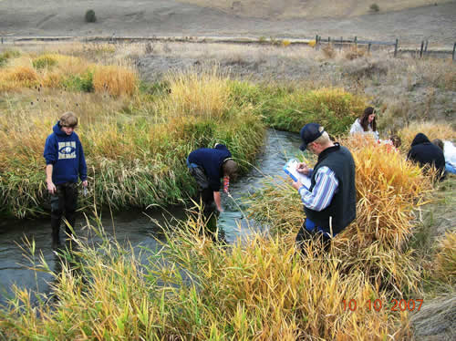

Slide 16
Survey of animals in a freshwater stream.
species | Number (n) | n / N | (n / N)²
Gammarus pulex ( water shrimp) | 150
Asellus aquaticus ( water louse) | 32
Baetis rhodani ( mayfly nymph) | 113
Lymnaea peregra ( snail) | 2
Rhyacophila ( caddis-fly nymph) | 12
Chironimidae ( midge larvae) | 210
Total
Calculate Simpsons diversity index D

Slide 17
Survey of animals in a freshwater stream.
species | Number (n) | n / N | (n / N)²
Gammarus pulex ( water shrimp) | 150
Asellus aquaticus ( water louse) | 32
Baetis rhodani ( mayfly nymph) | 113
Lymnaea peregra ( snail) | 2
Rhyacophila ( caddis-fly nymph) | 12
Chironimidae ( midge larvae) | 210
Total | 519

Slide 18
Survey of animals in a freshwater stream.
species | Number (n) | n / N | (n / N)²
Gammarus pulex ( water shrimp) | 150 | 0.289
Asellus aquaticus ( water louse) | 32 | 0.062
Baetis rhodani ( mayfly nymph) | 113 | 0.218
Lymnaea peregra ( snail) | 2 | 0.004
Rhyacophila ( caddis-fly nymph) | 12 | 0.023
Chironimidae ( midge larvae) | 210 | 0.405
Total | 519

Slide 19
Survey of animals in a freshwater stream.
species | Number (n) | n / N | (n / N)²
Gammarus pulex ( water shrimp) | 150 | 0.289 | 0.084
Asellus aquaticus ( water louse) | 32 | 0.062 | 0.004
Baetis rhodani ( mayfly nymph) | 113 | 0.218 | 0.047
Lymnaea peregra ( snail) | 2 | 0.004 | 0.000016
Rhyacophila ( caddis-fly nymph) | 12 | 0.023 | 0.000529
Chironimidae ( midge larvae) | 210 | 0.405 | 0.164
Total | 519 |  | ∑ = 0.299

Slide 20
Survey of animals in a freshwater stream.
species | Number (n) | n / N | (n / N)²
Gammarus pulex ( water shrimp) | 150 | 0.289 | 0.084
Asellus aquaticus ( water louse) | 32 | 0.062 | 0.004
Baetis rhodani ( mayfly nymph) | 113 | 0.218 | 0.047
Lymnaea peregra ( snail) | 2 | 0.004 | 0.000016
Rhyacophila ( caddis-fly nymph) | 12 | 0.023 | 0.000529
Chironimidae ( midge larvae) | 210 | 0.405 | 0.164
Total | 519 |  | ∑ = 0.299
D = 1 – [ ∑ ( n / N)² ]

Slide 21
Survey of animals in a freshwater stream.
species | Number (n) | n / N | (n / N)²
Gammarus pulex ( water shrimp) | 150 | 0.289 | 0.084
Asellus aquaticus ( water louse) | 32 | 0.062 | 0.004
Baetis rhodani ( mayfly nymph) | 113 | 0.218 | 0.047
Lymnaea peregra ( snail) | 2 | 0.004 | 0.000016
Rhyacophila ( caddis-fly nymph) | 12 | 0.023 | 0.000529
Chironimidae ( midge larvae) | 210 | 0.405 | 0.164
Total | 519 |  | ∑ = 0.299
D = 1 – [ ∑ ( n / N)² ]
D = 1 – 0.299
= 0.7

Slide 22
“Explain this result” (3)
An index value of 0.7 means there is a high probability that any two individuals taken from this stream will be from different species.
The stream shows good species richness and evenness.
The stream is more likely to withstand changes such as pollution.

Slide 23
Measuring Biodiversity – self check
Do you know?
Species richness
Species evenness
Simpson’s Index of Diversity (D)

